Slide 1
Towards Parameter-Free Data Mining
报告人：Jorfun

Slide 2
INTRODUCTION
Most data mining algorithms require the setting of many input parameters.
Dangers of working with parameter-laden algorithms.
may fail to find true patterns because of poorly chosen parameter settings
algorithm may report spurious patterns that do not really exist, or greatly overestimate the significance of the reported patterns. (likely when the user fails to understand the role of parameters)
difficult to compare the results across methods or even to reproduce the results of heavily parameterized algorithms

Slide 3
Introduction
Data mining algorithms should have as few parameters as possible, ideally none. A parameter-free algorithm prevents us from imposing our prejudices and presumptions on the problem at hand, and let the data itself speak to us.
In this work, we introduce a data mining paradigm based on compression.
Advantages：
Allows true exploratory data mining
Accuracy of our approach can be greatly superior to those of parameter-laden algorithms
Based on compression as its cornerstone, and compression algorithms are typically space and time efficient.
Many parameterized algorithms require the data to be in a special format. Our approach works for time series of different lengths, sampling rates, dimensionalities, with missing values, etc.

Slide 4
The Perils of Parameter-Laden Algorithms
While there are many techniques for automatically tuning parameters, many of these techniques themselves have parameters, possibly resulting in an infinite regression.
An additional problem of parameter-laden algorithms is that they make it difficult to reproduce published experimental results, and to understand the contribution of a proposed algorithm.
In general, the potential asymmetry in parameter tuning effort effectively prevents us from evaluating the contribution of many papers.
Creating a dataset may be regarded as a form of meta parameter tuning.
In any case, there are clearly problems in setting parameters (training) and reporting results (testing) on the same dataset.

Slide 5
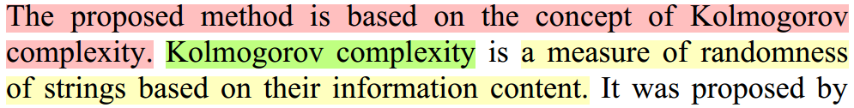
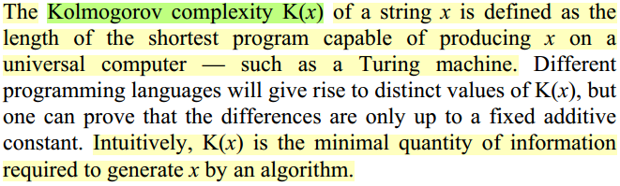
Kolmogorov Complexity Algorithms

Slide 6
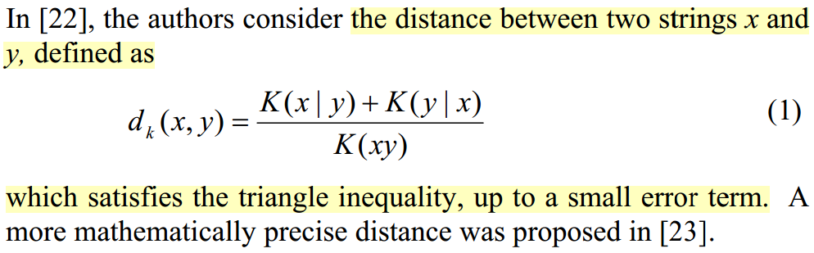
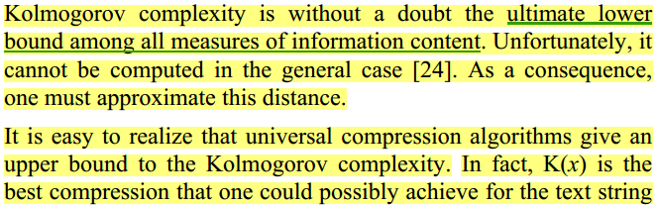
Kolmogorov Complexity Algorithms

Slide 7
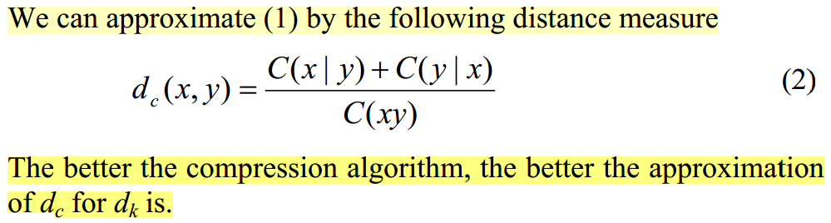
Kolmogorov Complexity Algorithms
The idea of using data compression to classify sequences is not new. (classify DNA sequences, classify fifty languages)
The idea of using compression to classify sequences is tightly connected with the minimum description length (MDL) principle.

Slide 8
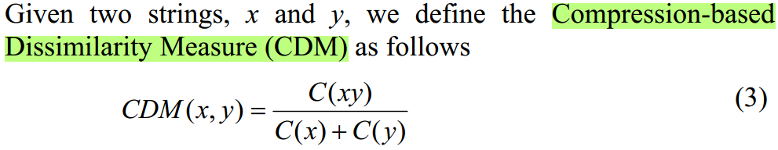
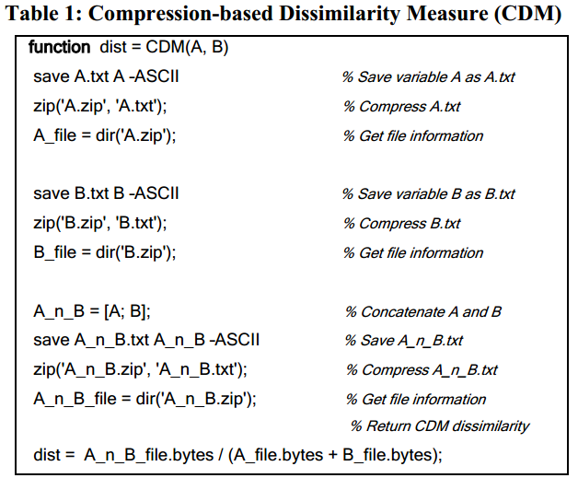
Compression-Based Dissimilarity Measure
The inputs are the two matrices to be compared. These matrices can be time series, DNA strings, images, natural language text, midi representations of music, etc.

Slide 9
Compression-Based Dissimilarity Measure
Algorithms
One could argue that also CDM has several parameters.
In fact, CDM depends on the choice of the specific compressor (gzip, compress, bzip2, etc.), and on the compression parameters (for example, the sliding window size in gzip).
But because we are trying to get the best approximation of the Kolmogorov complexity, one should just choose the best combination of compression tool and compression parameters for the data.
There is, in fact, no freedom in the choice to be made. We simply run these compression algorithms on the data to be classified and choose the one that gives the highest compression.

Slide 10
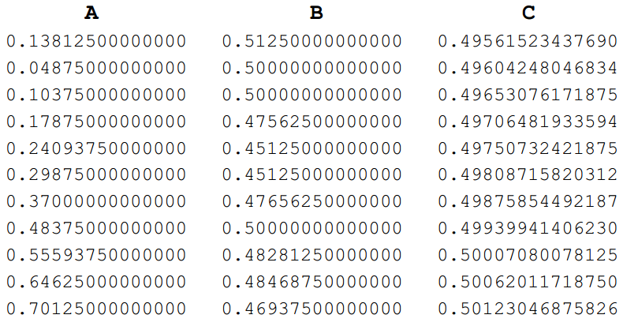
Choosing the Representation of the Data
The only objective in CDM is to obtain good compression.
One should try several compressors. If we have domain knowledge about the data under study, and specific compressors are available for that type of data, we use one of those.
There is another way we can help improve the compression; we can simply ensure that the data to be compared is in a format that can be readily and meaningfully compressed.
Problem ->

Slide 11
Choosing the Representation of the Data
A simple solution to problem noted above is to convert the data into a discrete format, with a small alphabet size. Every part of the representation contributes about the same amount of information about the shape of the time series.
Which to use?
SAX (Symbolic Aggregate Approximation)
This representation has been shown to produce competitive results for classifying and clustering time series, which suggest that it preserves meaningful information from the original data.
Similar remarks can be made for other data types, for example, when clustering web pages, we may wish to strip out the HTML tags first.

Slide 12
PARAMETER-FREE DATA MINING
Clustering
As CDM is a dissimilarity measure, we can simply use it directly in most standard clustering algorithms. For simplicity here, we will confine our attention to hierarchical clustering.
Anomaly Detection
For true parameter-free anomaly detection, we can use a divide and conquer algorithm.
The intuition is that the side containing the most unusual section will be less similar to the global sequence than the other half.
Classification
one-nearest-neighbor algorithm

Slide 13
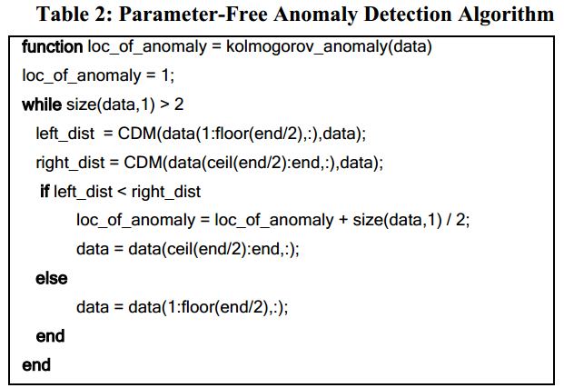
PARAMETER-FREE DATA MINING – ANOMALY DETECTION

Slide 14
PARAMETER-FREE DATA MINING – ANOMALY DETECTION
There are two simple ways to greatly improve it further.
use the SAX representation when working with time series.
introduce a simple and intuitive way to set parameter.
The algorithm in Table 2 allows several potential weaknesses for the sake of simplicity.
assumes a single anomaly in the dataset.
in the first few iterations, the measure needs to note the difference a small anomaly makes, even when masked by a large amount of surrounding normal data.
Solution: Window Comparison Anomaly Detection (WCAD)
Divide the input sequence into W contiguous sections, and assign the anomaly value of the ith window as CDM(Wi, data).
Bring new parameter to set?? For example of the ECG dataset discussed in Section 4.2.3, we found that we could find the objectively correct answer, if the size of the window ranged anywhere from a ¼ heartbeat length to four heartbeats.

Slide 15
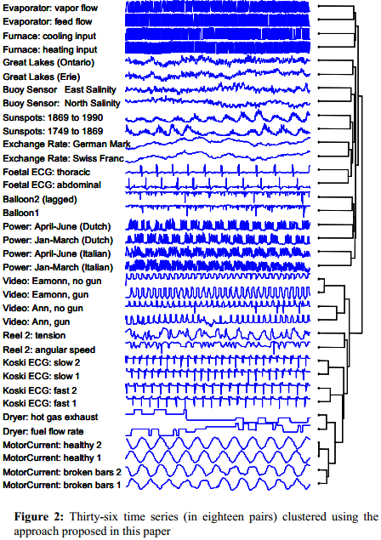
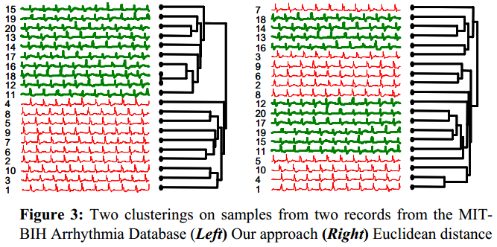
EMPIRICAL EVALUATION - Clustering
Clustering Time Series
Test our algorithm against all reasonable alternatives. Re-implemented every time series distance / dissimilarity / similarity measure that has appeared in the last decade. In total, we implemented fifty one such measures.

Slide 16
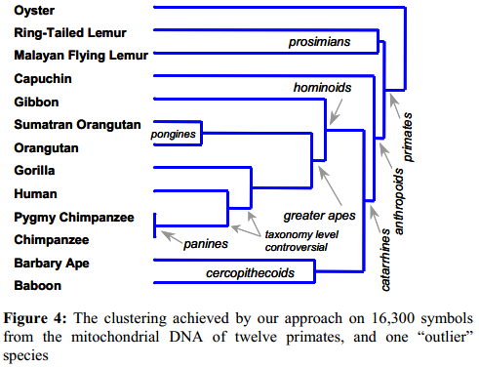
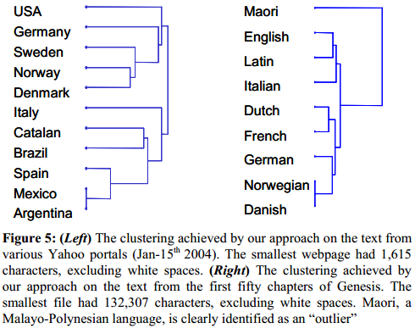
EMPIRICAL EVALUATION - Clustering
Clustering Text
Our point is simply to show that given a dataset in which we know nothing about, we can expect our CDM to produce reasonable results that can be a starting point for future study.

Slide 17
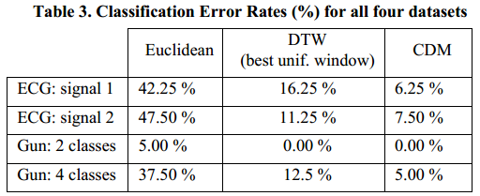
EMPIRICAL EVALUATION - Classification

Slide 18
EMPIRICAL EVALUATION – Anomaly Detection
Although our approach can be used to find anomalies in text, video, images, and other data sources, we will confine our attention here to time series.
Divide and Conquer - only tells us the location of the anomaly, without telling us anything about the relative strength of the anomaly.
Window Comparison Anomaly Detection (WCAD)
strength of the anomaly -> line’s thickness
In these experiments, we only count an experiment as a success for CDM if the first window size we choose finds the anomaly, and if window sizes four times as large, and one quarter as large, can also find the anomaly.
Competitors: Support Vector Machine (SVM) based approach of [28] (6), the Immunology (IMM) inspired approach of [4] (5), The Association Rule (AR) based approach of [36] (5), and the TSA-tree Wavelet based approach of [33] (3).

Slide 19
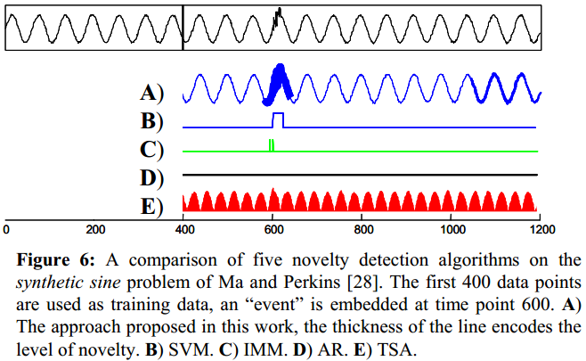
EMPIRICAL EVALUATION – Anomaly Detection
A Simple Normalizing Experiment

Slide 20
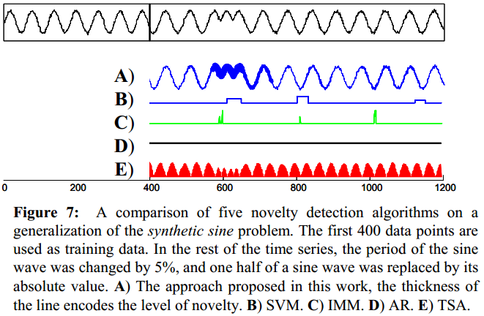
EMPIRICAL EVALUATION – Anomaly Detection
Generalizability Experiment
To illustrate the dangers of working with parameter-laden algorithms, we examined a generalization of the last experiment.

Slide 21
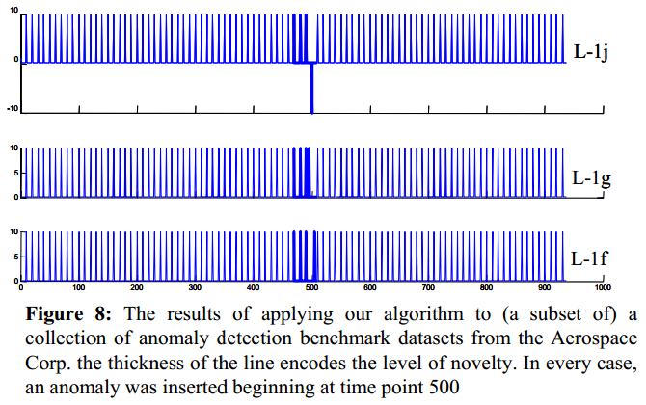
EMPIRICAL EVALUATION – Anomaly Detection
The objective of these experiments is to reinforce the main point of this work. Given the large number of parameters to fit, it is nearly impossible to avoid overfitting.

Slide 22
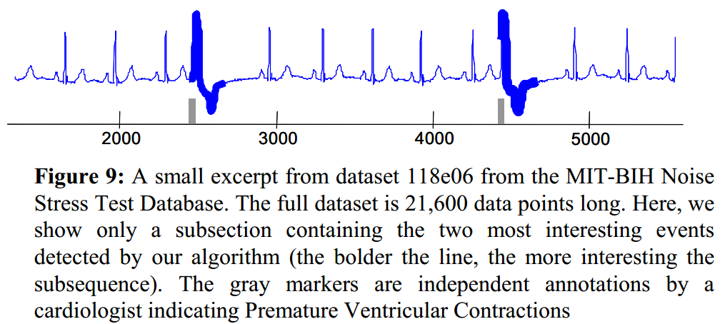
EMPIRICAL EVALUATION – Anomaly Detection
Real-World Anomaly Detection

Slide 23
EMPIRICAL EVALUATION – Anomaly Detection
Our final example illustrates the flexibility of our approach. None of the approaches for anomaly detection in time series in the literature are defined for multidimensional time series.
We can consider multidimensional time series without changing a single line of code.

Slide 24
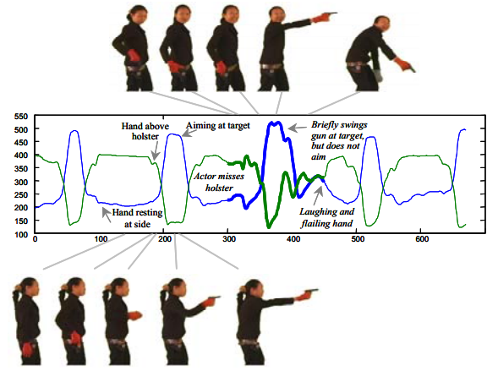
EMPIRICAL EVALUATION – Anomaly Detection

Slide 25
Conclusion
Data mining algorithms with many parameters are burdensome to use, and make it difficult to compare results across different methods.
Showed empirically that at least in the case of anomaly detection, parameter-laden algorithms are particularly vulnerable to overfitting. Sometimes they achieve perfect accuracy on one dataset, and then completely fail to generalize to other very similar datasets [7].
Finally, we note that our approach is clearly not suitable for classifying or clustering low dimensionality data (although Figure 2 shows exceptionally good results on time series with only 1,000 data points). We plan to theoretically and empirically investigate the limitations on object sizes that we can meaningfully work with using our proposed approach.

Slide 26
感谢聆听

